Slide 1
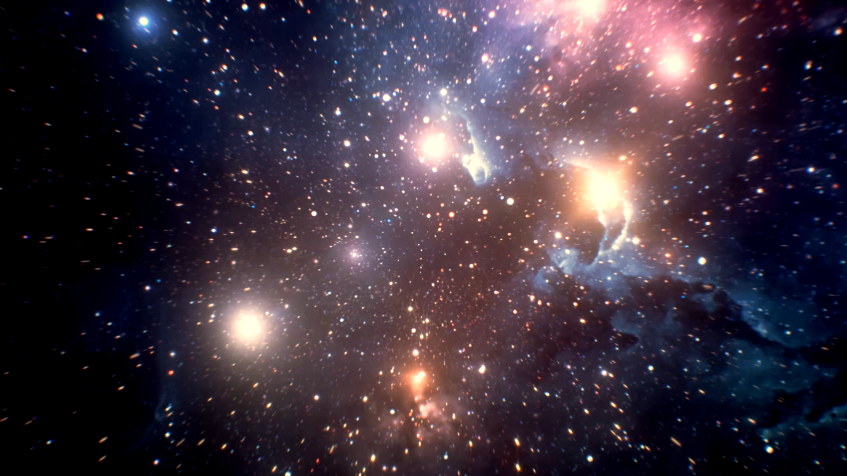

Space Titanic
Harlan Wittlieff
Data science, Bellevue university
DSC 680: Applied Data Science
Dr. Catie Williams
July 31, 2022
Notes:
Imagine a massive interstellar passenger liner, the Spaceship Titanic, colliding with a hidden spacetime anomaly. The collision sends passengers spiraling into another dimension! Now rescue crews need help saving the lost passengers.
This is the fun and exciting scenario set forth in a recent Kaggle competition.

Slide 2
Purpose
Predict which passengers of the spaceship were transported to another dimension
Use incomplete data from spaceship’s damaged computer system
Guide rescue crew efforts
Perform well on Kaggle competition project
Notes:
The purpose of this Space Titanic project is to predict which passengers of the spaceship were transported to another dimension using only the incomplete data that could be extracted form the damaged computer system onboard the interstellar passenger liner. The results of these models will guide the rescue crew efforts to save the passengers in the alternate dimensions from their demise. Being able to accurately predict which passengers were transported will also give insight for future intergalactic space voyages.
Ultimately, my goal in reality is to perform well on the Kaggle competition project.

Slide 3
Key considerations
Benefits
Optimize rescue efforts
Risks
Null values
Ethics
Potential for bias
Notes:
As with any data science project, there are specific considerations that must be taken into account.
Firstly, let us consider the benefits of this project. If the model succeeds, the efforts of the rescue team may be optimized.
The risks must also be accounted for. There is a risk relating to the null values. Assumptions had to be made around these null values. Identifying the correct way to handle the nulls is challenging.
Finally, any ethical considerations must also be taken into account. Due to this being a fictious scenario, the real-life ethical impacts are minimal. However, if this were a real situation, care would need to be taken to ensure that no classes of passengers were treated in a biased fashion. For example, VIP passengers should not be given any preferential treatment relative to the construction of the model.

Slide 4
Data
Source: “Spaceship Titanic” – Kaggle
8,693 passenger records
4,378 passengers in alternate dimension
“Transported” – Target Variable
Preparation
Handle null values
Additional feature creation
Replace True/False values
Notes:
Kaggle already separated this data into a training and test datasets featuring the following variables:
• Passenger ID – Unique Identifier • Home Planet • Cryo Sleep • Cabin • Destination • Age • VIP • Room Service • Food Court • Shopping Mall • Spa • VR Deck • Name • Transported
To begin preparing and exploring the data, I first checked for null values. Several features contained nulls. The features RoomService, FoodCourt, ShoppingMall, Spa, and VRDeck all had their nulls replaced with zeros as these features represented amounts spent on various amenities aboard the ship. Nulls in the VIP & CryoSleep features were replaced with False. Lastly the nulls in the Age feature were replaced by the mean age of the dataset. Nulls in categorical features were left in the dataset.
Three additional features were created from the dataset. Deck and Side (port or starboard) were extracted from the Cabin feature to provide richer information on where the passenger was staying to the model. The number of passengers in each specific group was added to the features. This feature was extracted from the PassengerId field.
Lastly, True and False values within the data were replaced by the binary values 0 and 1.

Slide 5
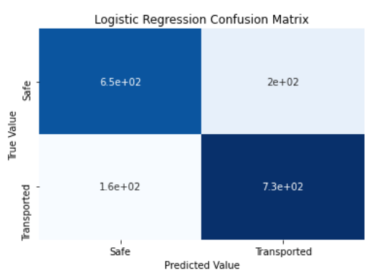
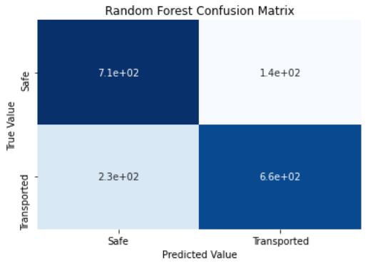
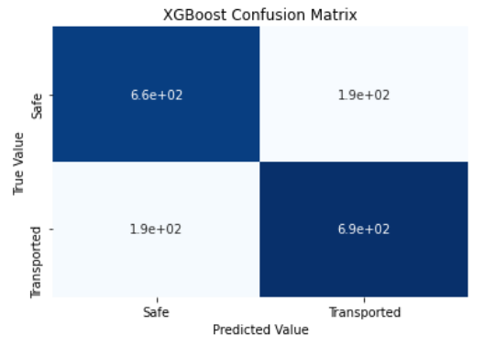
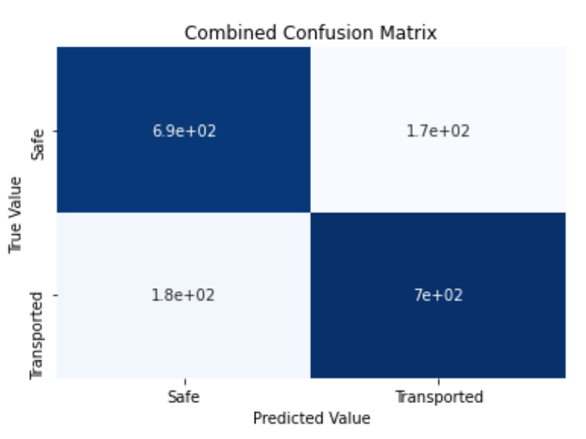
Models & Results
Logistic Regression – 79.4% Accuracy
Random Forest – 78.5% Accuracy
XGBoost – 78.0% Accuracy
Combined – 79.9% Accuracy
Notes:
The models for this data science project included logistic regression, random forest, and XGBoost.
Since the data classes are balanced, the main method of analyzing the models is the accuracy of the predictions on the test dataset which are as follows: 1. Logistic Regression: 79.4% 2. Random Forest: 78.5% 3. XGBoost: 78.0% The logistic regression model performed the best on the test dataset with an accuracy of 79.4%. Confusion matrices were then built for each model to further evaluate the results.
With the individual model test results completed, a final model was built that combined the results from each individual model. The average prediction between the Logistic Regression, Random Forest, and XGBoost models was taken and used as the predicted value in this final model. This combined model was able to achieve an accuracy of 79.9%. That’s an increase of 0.6% from the best individual model.

Slide 6
Recommendations
Model for Implementation: Combined Model
Additional Applications
Potential for real-life accident classification problems
Notes:
Based on the model evaluations, the logistic regression model was the best individual model. However, combining the three models proved to be the best solution overall with an accuracy of 79.9%.
Although this was a fictional dataset, the methodology may have applications in real-life accident classification problems. Adding a neural network model both individually and as a voting member of the combined model may bear additional fruit.

Slide 7
Concluding remarks
Model Performance in Kaggle Competition
Combined – 0.79658
XGBoost – 0.79448
Logistic Regression – 0.79191
Random Forest – 0.78723
Notes:
After completed the analysis on each model, the final step was to build the predictions on the test dataset and submit the predictions to Kaggle. Each of the four models had their predictions entered.
As expected, the combined model proved to be the most accurate in the competition. Surprisingly during our initial model testing, the XGBoost model performed the worst. However, during the competition it performed the best out of the three individual models. Upon completion of the competition, the results will be followed up on for additional learning opportunities

